Slide 1
Evaluation of asset pricing models on NASDAQ100

Slide 2

Question : To what extent can the variance of NASDAQ 100 be explained by one of the four
models? Which model can explain the variance the best?
Overview :
1.
2.
3.
Data Collection
Portfolio
Construction
Model Validation and Performance Measure
CAPM
Variance Inflation Factor (VIF)
Bayesian Information Criterion (BIC)
Fama-French 3 Factor model
Studentized Breusch-Pegan
Adjusted $R^{2}$
Cahart 4 Factor model
F-Statistics
Breusch-Godfrey test
Fama-French 5 Factor model
ACF – Autocorrelation Function

Slide 3
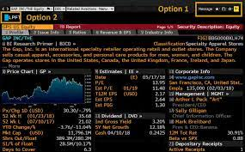
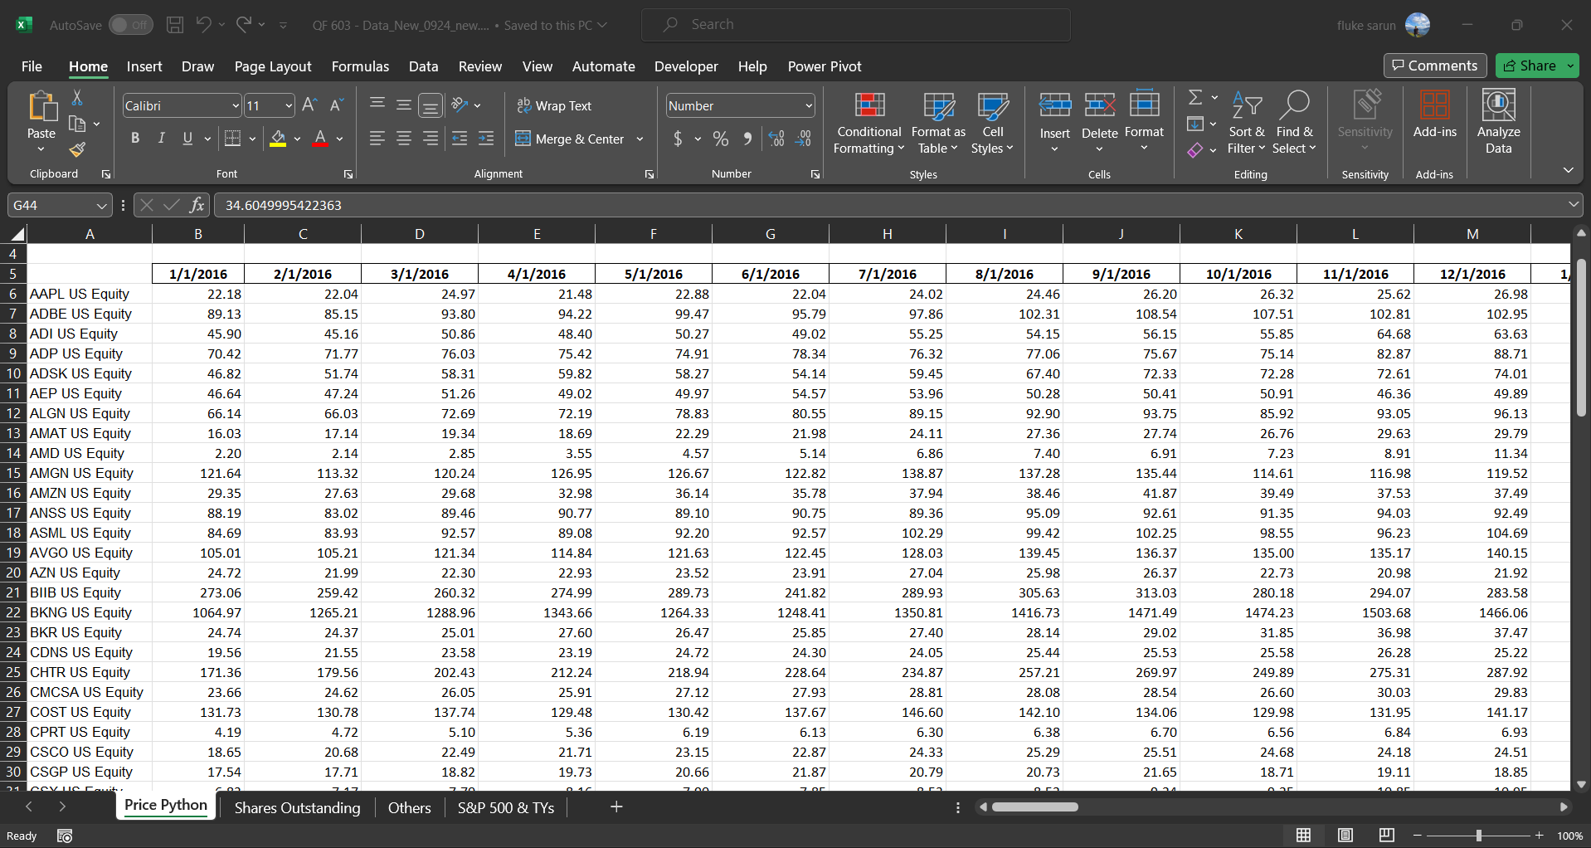
Portfolio
3.
1.
2.
Data Collection
Construction
Model Validation and Performance measure
Start constructing portfolios for factors calculation
Data for modeling
2016
2017
2018
2019
2020
2021
2022
Start of July 2017
End of June 2022
Collecting Data
For each of stock in Nasdaq 100:
- Monthly Closing Price
- Quarterly Shares Outstanding
Other data:
- Annual Operating Income
- US treasury yield (Monthly)
- S&P 500 monthly index
Our main source of financial data are Bloomberg and alpha vantage library in Python.
- Annual Interest Expense
- Annual Total Assets
- Annual Total Equity

Slide 4









Portfolio
3.
1.
2.
Data Collection
Construction
Model Validation and Performance measure
Models
1.) Capital market model (CAPM) : $R_{i}−R_{f}=α_{i}+ β\left(R_{m}−R_{f}\right)+{ε_{i}}_{t}$
2.) Fama-French 3 factor model (FF3) : $R_{i}−R_{f}=α_{i}+ β_{1}\left(R_{m}−R_{f}\right)+β_{2}\left(SMB_{t}\right)+β_{3}\left(HML\right)+ε_{t}$
$$R_{i}−R_{f}=α_{i}+ β_{1}\left(R_{m}−R_{f}\right)+β_{2}\left(SMB_{t}\right)+β_{3}\left(HML\right)+β_{4}\left(MOM\right)+ε_{t}$$
3.) Carhart 4 factor model (CH4) :
$$R_{i}−R_{f}=α_{i}+ β_{1}\left(R_{m}−R_{f}\right)+β_{2}\left(SMB_{ff5}\right)+β_{3}\left(HML\right)+β_{4}\left(RMW\right)$$
4.) Fama-French 5 factor model (FF5) :
$${+ β}_{5}(CMA){+ε}_{t}$$
Factors
$$SMB_{t}=\frac{s\backslash l+s\backslash m+s\backslash h}{3} −\frac{b\backslash l+b\backslash m+b\backslash h}{3}$$
$$RMW =\frac{s\backslash r+b\backslash r}{2} −\frac{s\backslash w+b\backslash w}{2}$$
$$HML=\frac{s\backslash h+b\backslash h}{2} −\frac{s\backslash l+b\backslash l}{2}$$
$$MOM=\frac{s\backslash w+b\backslash w}{2} −\frac{s\backslash lo+b\backslash lo}{2}$$
$$SMB_{INV}=\frac{s\backslash a+s\backslash n+s\backslash c}{3} −\frac{b\backslash a+b\backslash n+b\backslash c}{3}$$
$$SMB_{FF5}=\frac{SMB_{B/M}+SMB_{OP}+SMB_{INV}}{3}$$
$$CMA=\frac{s\backslash c+b\backslash c}{2} −\frac{s\backslash a+b\backslash a}{2}$$
$$SMB_{op}=\frac{s\backslash w+s\backslash n+s\backslash r}{3} −\frac{b\backslash w+b\backslash n+b\backslash r}{3}$$

Slide 5






Portfolio
3.
1.
2.
Data Collection
Construction
Model Validation and Performance measure
30% Low
s/l
Small stock / Low book to market value
The portfolios were reconstructed at the beginning of July of every year and was used from July of year T to the end of June of year T+1.
Percentile of Book value by Market capitalization
40% Neutral
s/n
Small stock / Neutral book to market value
30% High
s/h
Small stock / High book to market value
30% Weak
s/w
Small stock / Weak operational profitability
Percentile of Operational Profit
40% Neutral
s/m
Small stock / Neutral operational profitability
30% Robust
s/r
Small stock / Robust operational profitability
Percentile of Growth in Total asset
30% Conservative
s/c
Small stock / Conservative Investment
40% Medium
s/n
Small stock / Medium Investment
30% Aggressive
s/a
Small stock / Aggressive Investment
30% Losers
s/lo
Small stock / Loser Total Return Index
Percentile of Yearly return of stock
40%
50% Small
30% Winners
s/wi
Small stock / Winner Total Return Index
Companies in NASDAQ 100
Median of
Market capitalization
$$SMB_{ff5}$$
$$SMB_{t}$$
$$MOM$$
50% Big
Percentile of Yearly return of stock
$$CMA$$
$$RMB$$
$$HML$$
30% Losers
b/lo
Big stock / Loser Total Return Index
40%
Big stock / Winner Total Return Index
Out of 22 portfolios, we selected 18 portfolios that were constructed by fundamental criteria, and used them as a dependend variable in asset pricing models.
30% Winners
b/wi
Percentile of Growth in Total asset
30% Conservative
b/c
Big stock / Conservative Investment
40% Medium
b/n
Big stock / Medium Investment
30% Aggressive
b/a
Big stock / Aggressive Investment
Percentile of Operational Profit
30% Weak
b/w
Big stock / Weak operational profitability
40% Neutral
b/m
Big stock / Neutral operational profitability
30% Robust
b/r
Big stock / Robust operational profitability
Percentile of Book value by Market capitalization
30% Low
b/l
Big stock / Low book to market value
40% Neutral
b/n
Big stock / Neutral book to market value
30% High
b/h
Big stock / High book to market value

Slide 6

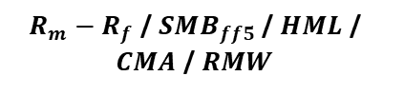


Portfolio
3.
1.
2.
Data Collection
Construction
Model Validation and Performance measure
3.1) Variance Inflation Factor (VIF)
Result of VIF:
$$VIF=\frac{1}{1 −R_{i}^{2}}$$
Fama French 3 Factor model :
$R_{m}−R_{f}$ / $SMB$ / $HML$
Carhart 4 Factor model :
$R_{m}−R_{f}$ / $SMB$ / $HML$ / $MOM$
One of the methods we used to validate the model is the VIF.
The VIF measures the severity of multicollinearity in the ordinary least square regression analysis.
Generally, a VIF above 4 indicates that multicollinearity might exist and further investigation is required.
Based on the results we have achieved, the VIF is generally less than 2.5, which indicates moderate multicollinearity.
Hence, it suggests that multicollinearity is not a substantial concern among the variables.
Fama French 5 Factor model :
$R_{m}−R_{f}$ / $SMB_{ff5}$ / $HML$ / $CMA$ / $RMW$

Slide 7
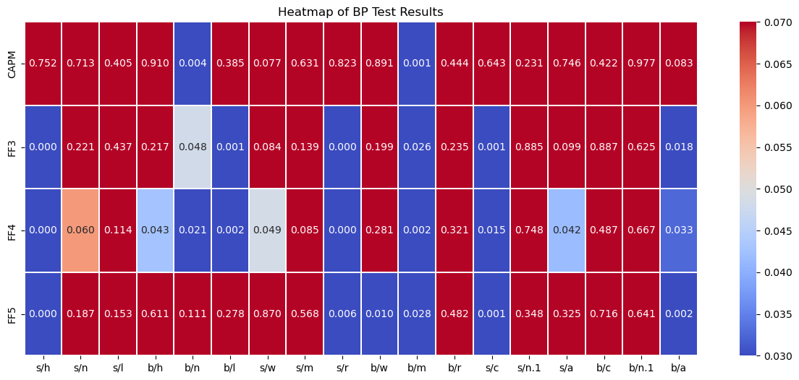

Portfolio
3.
1.
2.
Data Collection
Construction
Model Validation and Performance measure
3.2) Breusch–Pagan test
$$H_{0}=σ_{ε1}^{2}=σ_{ε2}^{2}=σ_{ε3}^{2}= …. =σ_{ε}^{2}$$
Result of BP test

Slide 8
Portfolio
3.
1.
2.
Data Collection
Construction
Model Validation and Performance measure
3.2) Breusch–Pagan test
$$H_{0}=σ_{ε1}^{2}=σ_{ε2}^{2}=σ_{ε3}^{2}= …. =σ_{ε}^{2}$$
Explanation for BP test and result
- One of the assumptions of the classical linear regression model is the constant variance in the error terms. Breaking this assumption means estimators are no longer the best Linear Unbiased Estimators because their variances are not the lowest. If we assume there is no heteroskedasticity but in reality there exists, we will get unbiased but inefficient estimates and biased standard errors.
- And BP test is used to test the heteroskedasticity in a linear regression model. The test is derived from Lagrange multiplier, and approximately follows the χ 2 distribution with the null hypothesis of a constant variance. So, if the p-value is below than 0.05 then we reject the null hypothesis.
- From our result, the variable b/m in all 4 models is less than 0.05, which means "b/m" has a significant impact on the heteroskedasticity . We may consider transforming this variable. Like non-linear transformations.
And s/h, s/r, s/c and b/a show the similar situation in other models except CAPM. We could consider some correlation methods like weighted least squares model or heteroskedasticity -robust method to address the effect.
- Overall, CAPM is more tolerant of the heteroskedasticity , while other models could be more sensitive. And for our dataset, the Fama-French 5-factor model is also an acceptable model that provides relatively stable results.

Slide 9
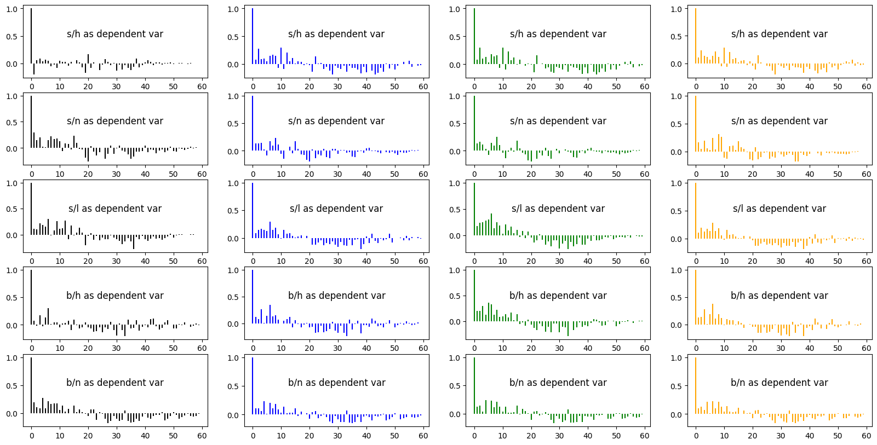

Portfolio
3.
1.
2.
Data Collection
Construction
Model Validation and Performance measure
$$r_{k}=\frac{\sum_{t=k+1}^{T}{(y_{t} −\overline{y})(y_{t−k} −\overline{y})}}{\sum_{t=1}^{T}{{\left(y_{t} −\overline{y}\right)}^{2}}}$$
3.3) Autocorrelation Function
ACF of an error term:
- We use Autocorrelation Function (ACF) with the error to check if there's any hidden pattern or correlation in the residuals
- Overall, for all of the models, there is no significant autocorrelation between the error term and the lag value of itself.
18 plots per model

Slide 10
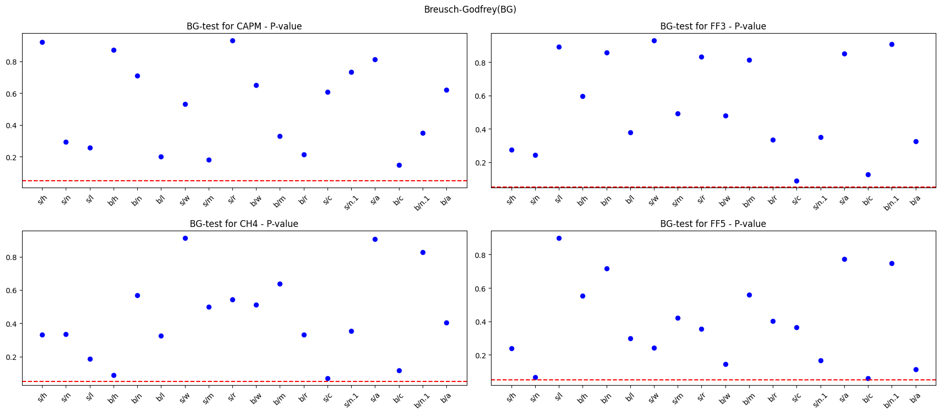

Portfolio
3.
1.
2.
Data Collection
Construction
Model Validation and Performance measure
3.4) Breusch-Godfrey test
$H_{0}=ρ_{1}=ρ_{2}$ = $ρ_{3}$ = … = $ρ_{p}$ = 0
Result of BG test

Slide 11
Portfolio
3.
1.
2.
Data Collection
Construction
Model Validation and Performance measure
3.4) Breusch-Godfrey test
$H_{0}=ρ_{1}=ρ_{2}$ = $ρ_{3}$ = … = $ρ_{p}$ = 0
Explanation for BG test and result
The Breusch-Godfrey test, often abbreviated as BG test, is a diagnostic tool used to detect the presence of autocorrelation in the residuals of a regression model. If present, autocorrelation can invalidate the results of our regression model, as it violates the assumption that the residuals are not autocorrelated.
We first estimate our regression model and obtain the residuals. Next, we regress these residuals on the original independent variable and the lagged values of the residuals. The test statistic is then computed, which follows a chi-squared distribution. We compare the test statistic to the critical value from the chi-squared distribution to determine the presence of autocorrelation. The null hypothesis, Ho, states that there is no autocorrelation up to the p-th order. If the p-value is below a 0.05 significance level, we reject the null hypothesis, indicating the presence of autocorrelation.
we've applied the BG test for each of four models: CAPM, FF3, CH4 and FF5. The dotted red line represents the significance level at 0.05. Looking at the p-values, any value below this line suggests the presence of autocorrelation in the residuals of that model.
From our BG test results, it show that all model consistently shows p-values above the 0.05 significance line, indicating no significant autocorrelation in its residuals across all the time frames considered. However, the absence of autocorrelation is just one aspect of model reliability. Other factors should also be considered when determining the overall best model.

Slide 12
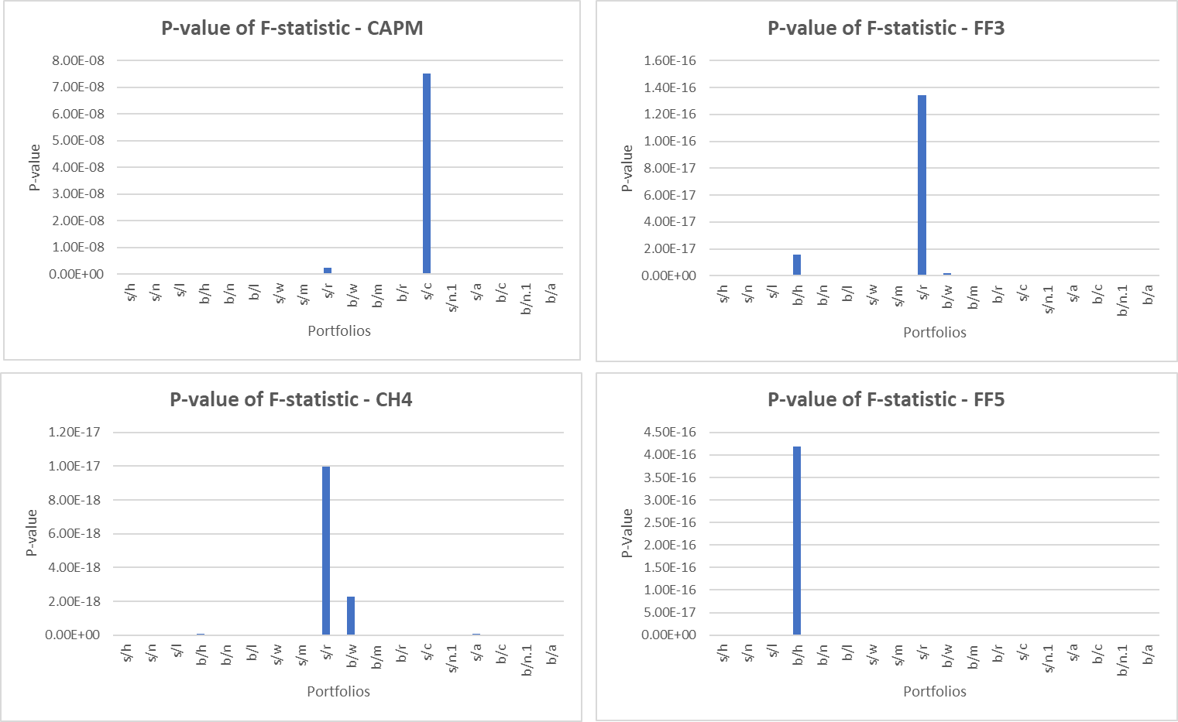
Portfolio
3.
1.
2.
Data Collection
Construction
Model Validation and Performance measure
3.5) Performance measurement – F-Statistic
Model | Average p-val
CAPM | 4.32e-09
FF3 | 8.43e-18
CH4 | 6.93e-19
FF5 | 2.33e-17
- F-statistic is used to measure the performance of the models. If the p-value is lower that 0.05, it means that the overall of our regression model is significant
- Based on these results, all the models are statistically significant since their p-values are very close to zero.

Slide 13
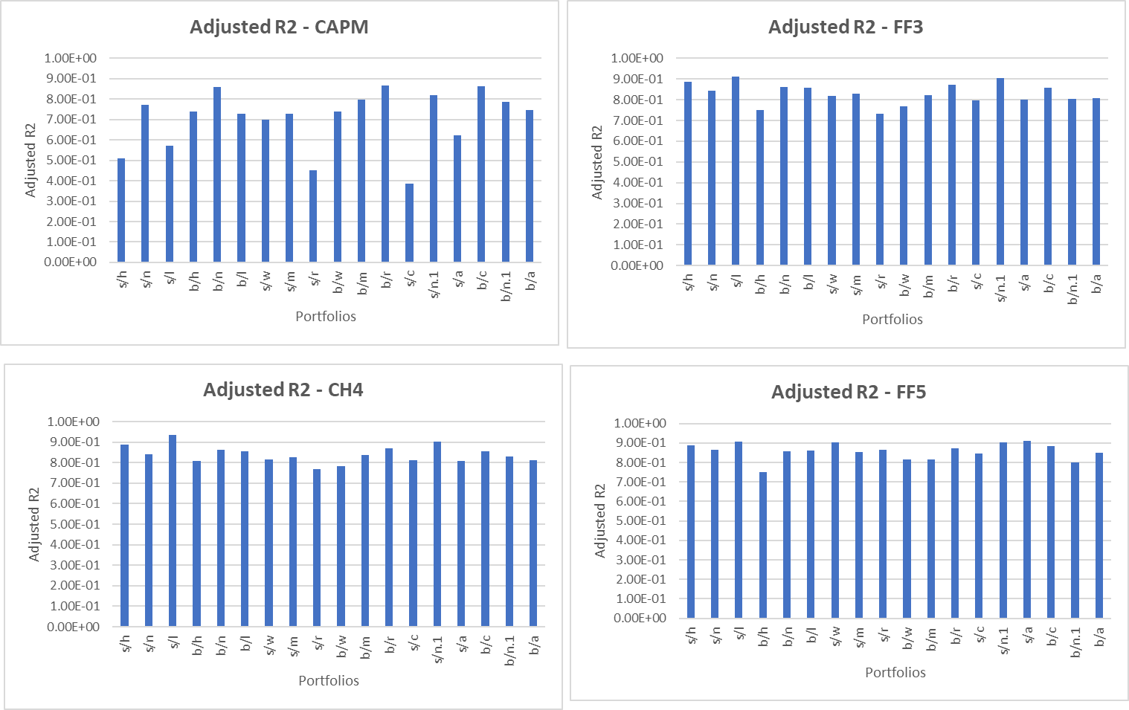
Portfolio
3.
1.
2.
Data Collection
Construction
Model Validation and Performance measure
3.6) Performance measurement – Adjusted $R^{2}$
Model | Average Adj. R2
CAPM | 0.705
FF3 | 0.829
CH4 | 0.840
FF5 | 0.859
- We used adjusted R2 to measure the performance of our models. It refers to how much of total variation is explained, with a penalizing factor for more parameters.
- Based on the result on the adjusted R2, FF5 seems to have the best explanatory power among all the models, followed closely by CH4, then FF3, and lastly, CAPM.

Slide 14
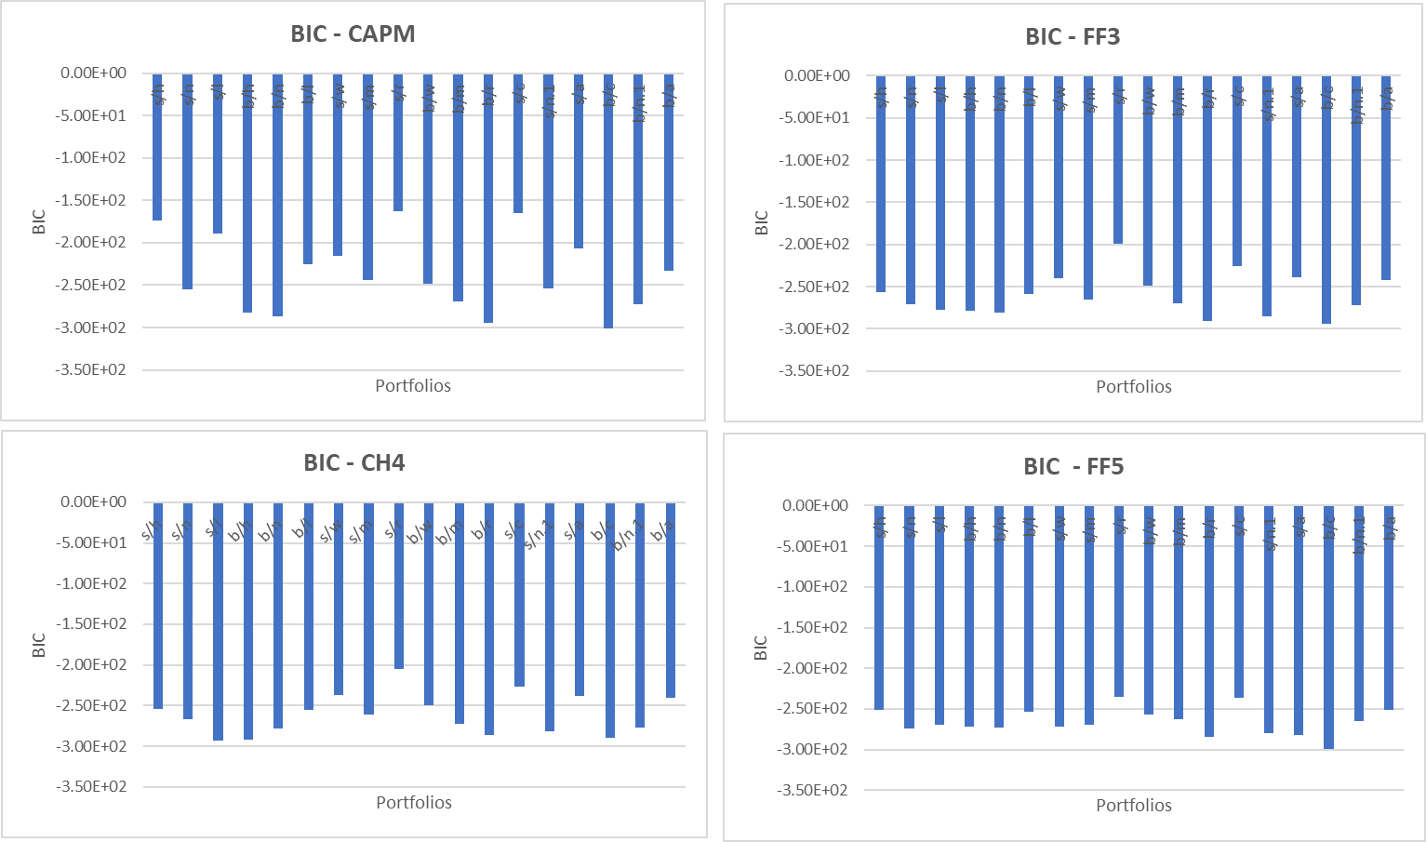
Portfolio
3.
1.
2.
Data Collection
Construction
Model Validation and Performance measure
3.7) Performance measurement – Bayesian Information Criterion (BIC)
Model | Average BIC
CAPM | -238
FF3 | -261
CH4 | -261
FF5 | -266
- We also used BIC to measure the performance of models. a lower BIC value indicates a better model fit.
- The result of BIC aligns in the same way as adjusted R2, that FF5 is the best fit model followed by CH4, FF3 and CAPM

